Slide 1
PIR sensor interfacing with Raspberry pi

Slide 2
Aim: To Interfacing HC-SR501 PIR Motion Sensor with Raspberry Pi and display a message on monitor Screen when motion is detected.
Apparatus
Raspberry pi 3 board
HC-SR501 PIR Motion sensor
Bread Board
Connecting wires

Slide 3
Theory:-
A PIR (Passive infrared) sensor can be used to detect these passive radiations. All living beings radiate energy to the surroundings in the form of infrared radiations which are invisible to human eyes. When an object (human or animal) emitting infrared radiations passes through the field of view of the sensor, it detects the change in temperature and therefore can be used to detect motion.
HC-SR501 is a PIR sensor which uses differential detection with two pyroelectric infrared sensors. By taking difference of the values, the average temperature from the field of view of sensor is removed and thereby reducing false positives.

Slide 4

The module has a rectangular window with two sub probes 1 and 2 located at two ends of the rectangle. When a body emitting infrared radiation moves from side to side, the time for each probe for detection varies. Larger the time difference, more sensitive the device. It also uses a Fresnel lens to improve sensing aperture and filter in infrared wave

Slide 5
Adjustment
For adjusting the detection delay (0.3 seconds to 600 seconds): Turn the potentiometer clockwise to increase and anticlockwise to decrease
For adjusting the sensing distance (3 meters to 7 meters): Turn the potentiometer clockwise to increase and anticlockwise to decrease

Slide 6
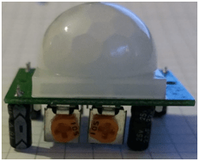
Interfacing HC-SR501 with Raspberry Pi is simple because the output of sensor is Pi responsive ie. 3.3V and it can be powered from the 5V rail of Pi.
HC-SR501 PIR sensor has 3 pins:
1) VCC
Connect to power supply (4.5v to 20V, typically 5V )
2) OUTPUT
Connect to raspberry pi pin (as per your program)
3 ) GND
Connect to GND supply

Slide 7
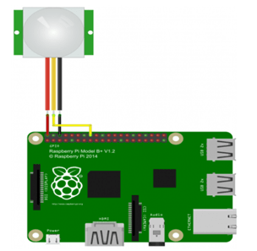
Circuit Connections
Connections:
 | PIR sensor | Raspberry Pi
1 | Vcc (RED wire) | Pin 2
2 | Output (Yellow wire) | Pin 16 (GPIO 23)
3 | Gnd (Black wire) | Pin 6

Slide 8
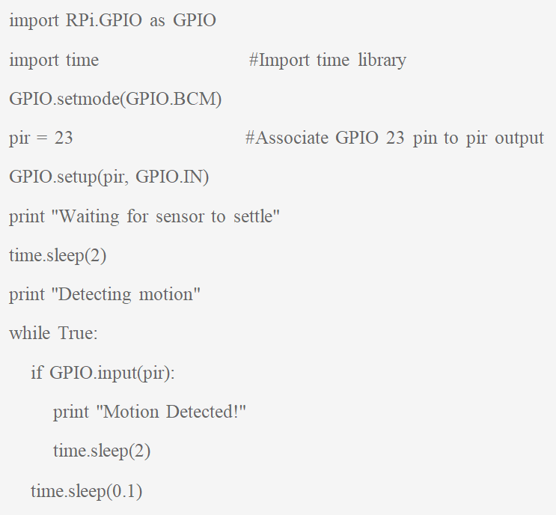
Program1

Slide 9
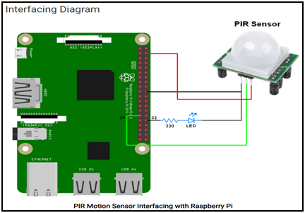
Circuit diagram2
 | PIR sensor connections | Raspberry Pi
1 | Vcc (RED wire) | Pin 2 (VCC)
2 | Output (Yellow wire) | Pin 29 (GPIO 23)
3 | GND (Black wire) | Pin 6 (GND)
 | LED connections | Raspberry Pi
1 | Anode to pin 32 through 330 ohms resistor and Cathode to GND | Pin 32 (GPIO 12)

Slide 10
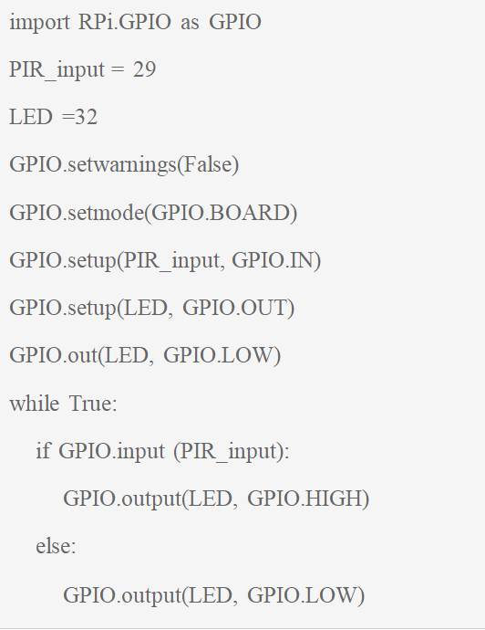
Program2:

Slide 11
Result : Interfaced HC-SR501 PIR Motion Sensor with Raspberry Pi and glow an LED when human motion is detected in front of PIR sensor up to 1 meter distance
Assignment :Write short answers to the following questions.
What can a PIR sensor be used for?
How PIR sensor works?
What is PIR sense motion in Arduino?
Explain the following commands
GPIO.setwarnings false
GPIO.setmode(GPIO.BCM)
5) Write any five features of HC-SR501 PIR Sensor.

Slide 12
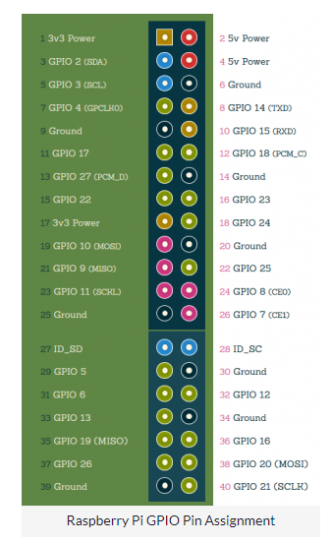
The Raspberry Pi’s have a 40-pin header. Not all of them can be read out or connected as there are also some voltage and ground connections. The following graphic lists the complete pins including functions and numbering. The left (green) side should symbolize the board of the Raspberry Pi.
All pins that have “GPIO” in their names can be programmed. There is also “Ground” (= ground connection) and the voltage pins (3.3V and 5V).
As you can see, there are two pin assignments: First the ascending pin assignment (starting at 1 in the top left) and then the rather random numbering of the GPIOs. This is important because you can address a GPIO via both numbers.
Pin 15 = GPIO 22, for example. Always pay attention to whether pin or GPIO is used. Most tutorials do not use the pin numbering, but the GPIO number.

Slide 13
We are importing a library with which we can program the Raspberry Pi GPIO pins. This library already contained all the required functions, so we do not have to write any additional functions for it.
import RPi.GPIO as GPIO
We also import a library with which we can stop the script for a short time. This will be interesting afterwards.
import time
Then we indicate whether we want to address the GPIOs via board numbers (1-40) or via their GPIO number. Since we want the latter, the command is:
GPIO.setmode(GPIO.BCM)

Slide 14
Now it goes back to the Python console, where we enter our code. First of all, we have to define the pin as output OR input
GPIO.setup(LED(OR 32), GPIO.OUT)
GPIO.setup(LED(OR 32), GPIO.IN)
The output functions for this pin are now available. With the following two commands we can firstly switch the LED on and then switch it off again:
GPIO.output(LED(OR 32), GPIO.HIGH)
GPIO.output(LED(OR 32), GPIO.LOW)
This command simply says whether a voltage of 3.3V (HIGH) or 0V (LOW) should be applied.

Slide 15
If you want to build a small flashing circuit, you can e.g. do the following:
for i in range(5):
GPIO.output(LED(OR 32), , GPIO.HIGH)
time.sleep(0.5)
GPIO.output(LED(OR 32), GPIO.LOW)
time.sleep(0.5)
This turns the LED on and off 5 times, waiting for half a second in between before changing the status.
GPIO.setwarnings false:-
As the message says add GPIO.setwarnings(False) to the start of your script to disable
warnings.

